Slide 1
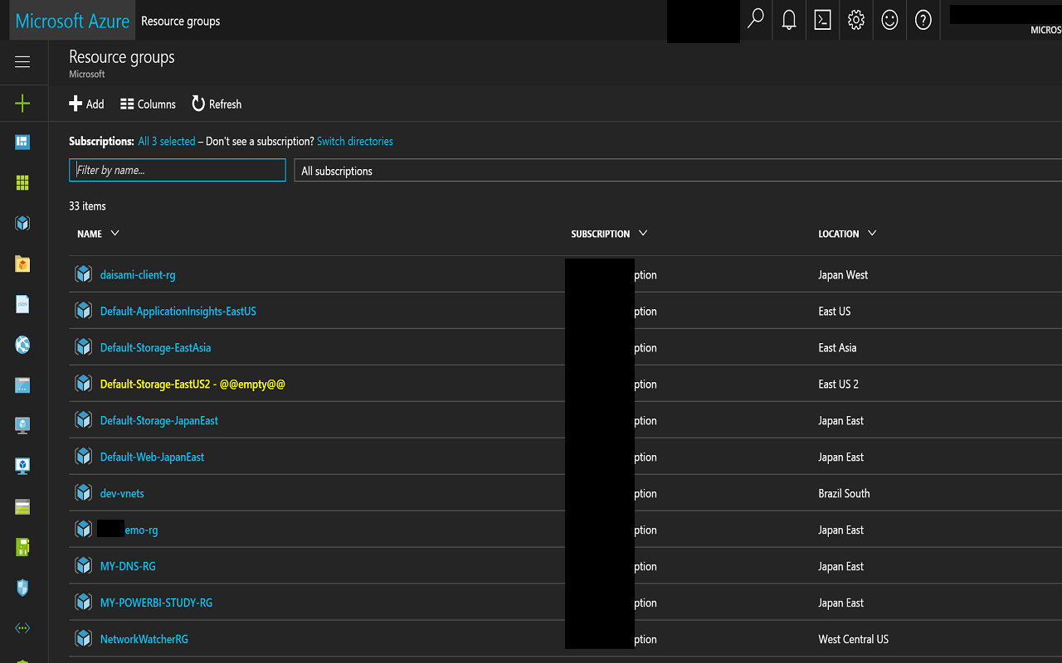
Highlight empty resource groups

Slide 2
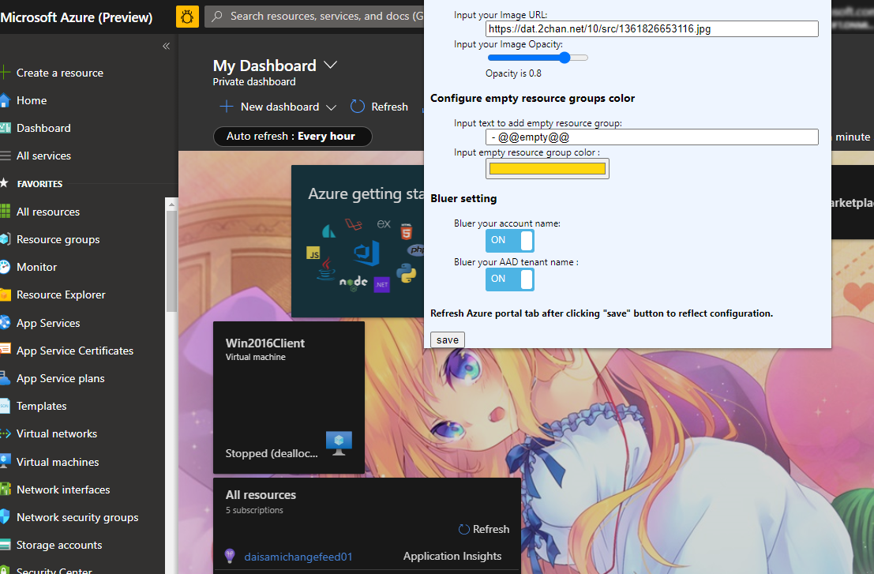
Setup background image

Slide 3
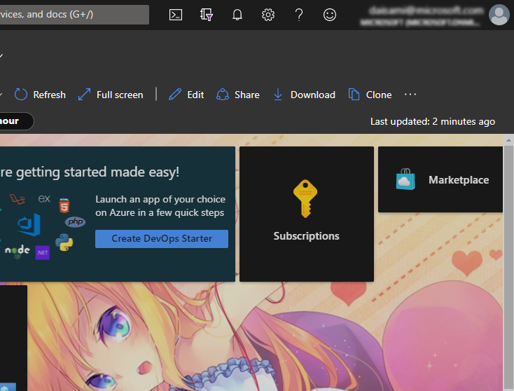
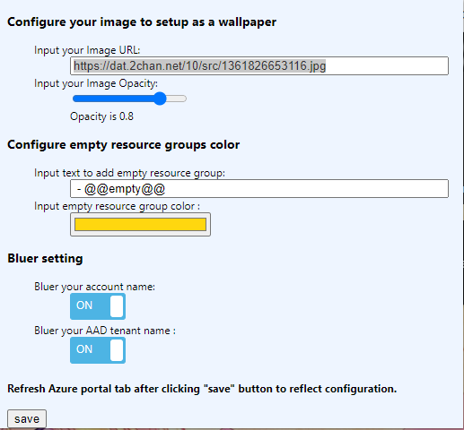
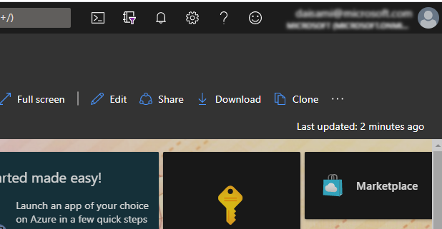
Mask your username and
Azure AD tenant name

Slide 5
Setup background image
Mask your username and
Azure AD tenant name

